Slide 1
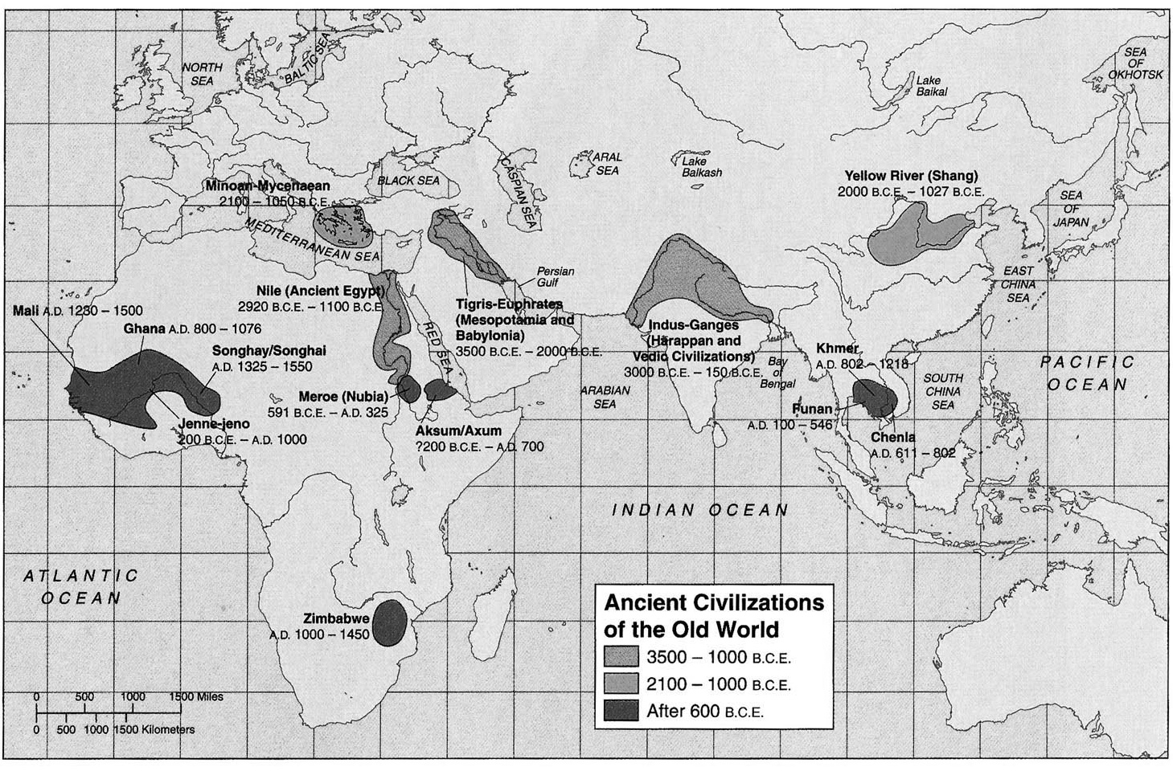
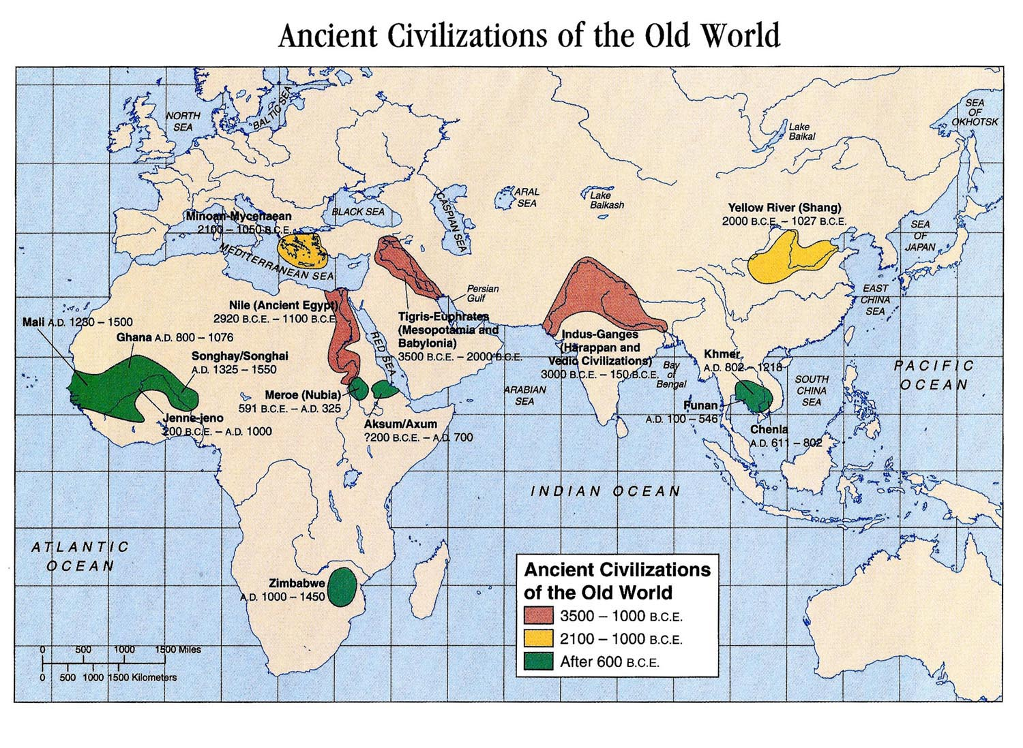
Dig Site: Ancient Mesopotamia

Slide 2
Dig Site: Ancient India

Slide 3
Dig site: Ancient China

Slide 4
Dig Site: Ancient Egypt

